Slide 1
Unit 9
Introduction to Virtual Reality

Slide 2
Contents
Concept of Virtual reality
Virtual Reality Components of VR System, Types of VR System, 3D Position Trackers, Navigation and Manipulation Interfaces
Application of VR

Slide 3
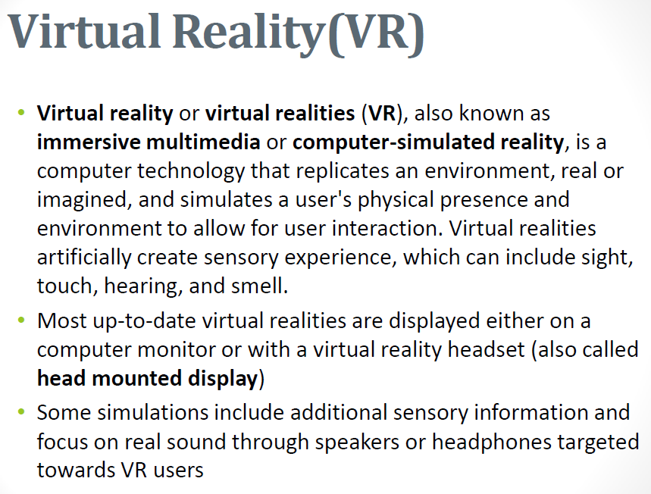

Slide 4
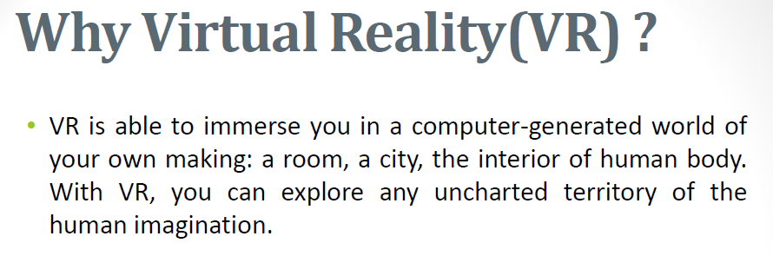

Slide 5
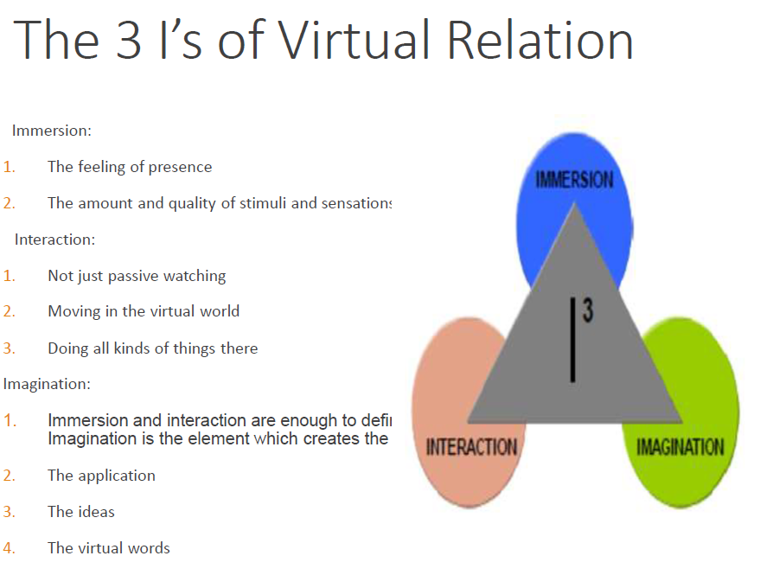

Slide 6
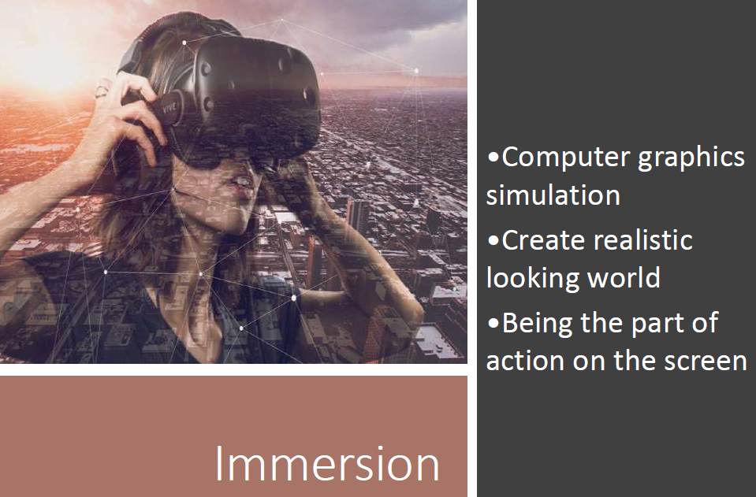

Slide 7
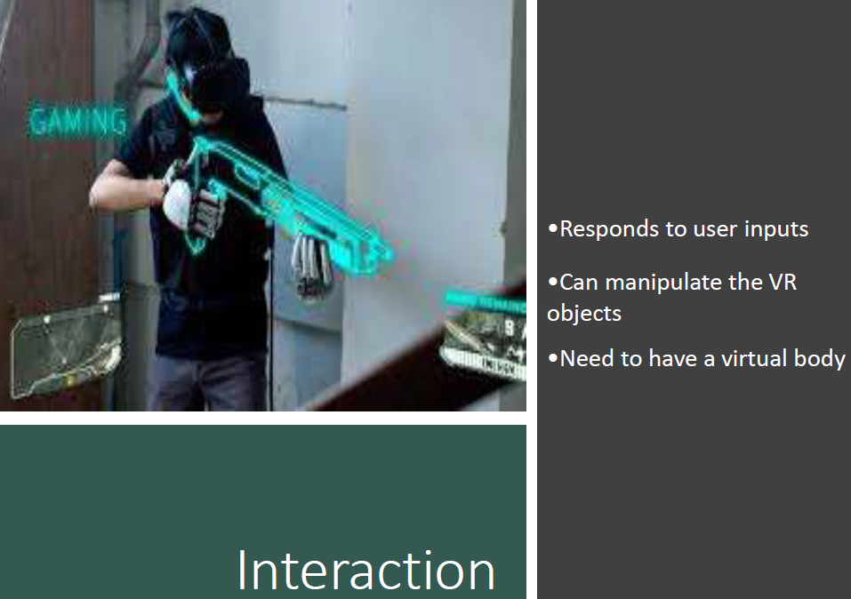

Slide 8
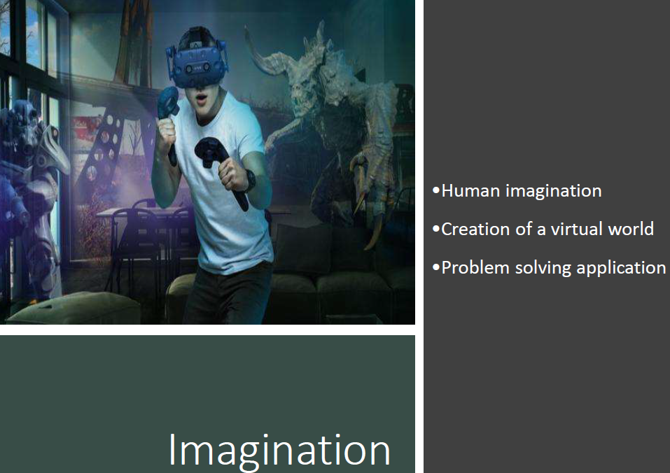

Slide 9
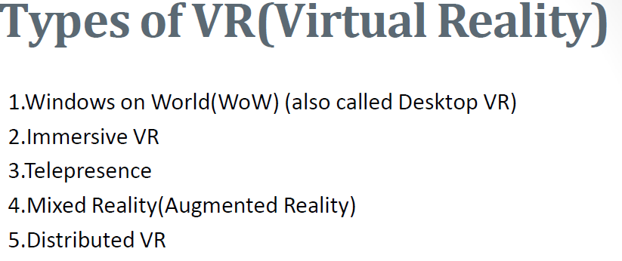

Slide 10
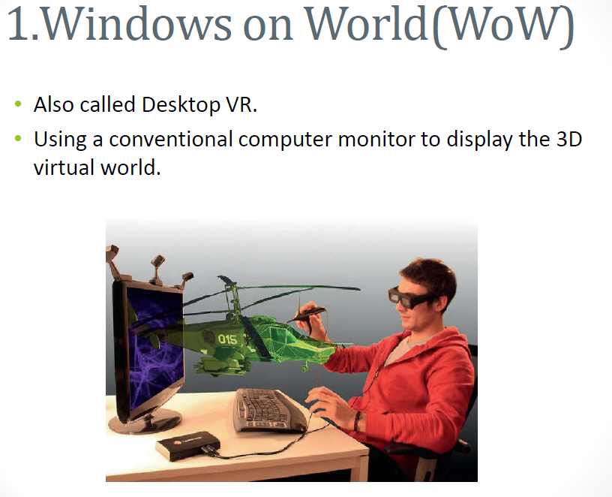

Slide 11
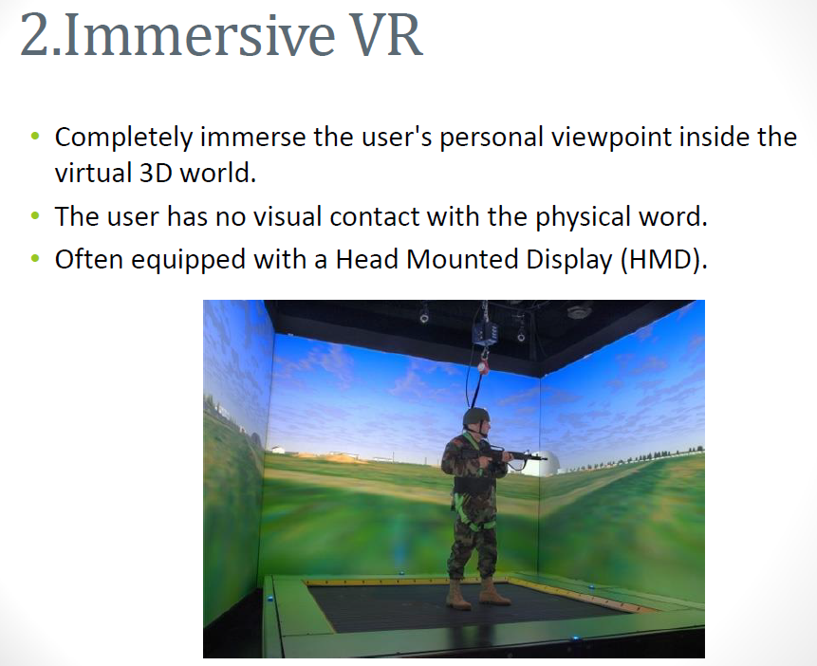

Slide 12
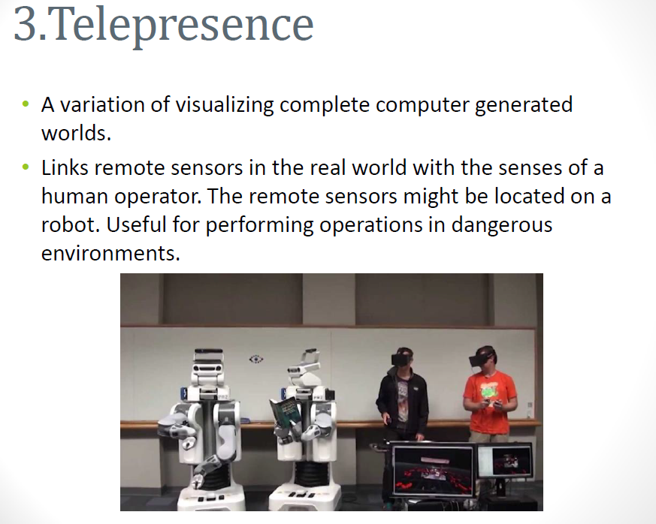

Slide 13
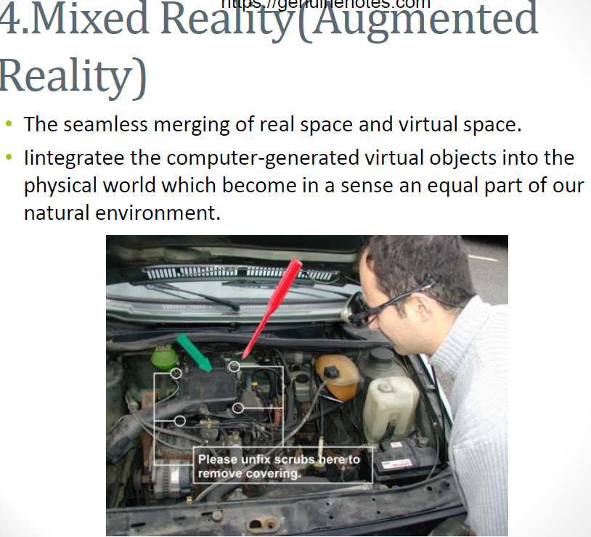

Slide 14
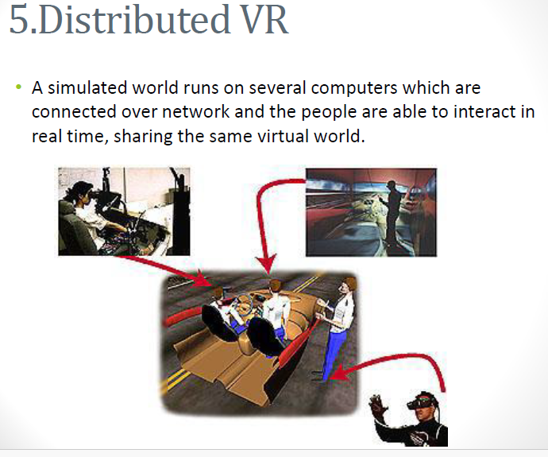

Slide 15
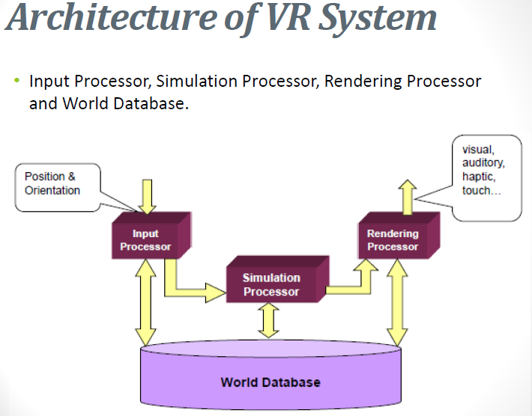

Slide 16
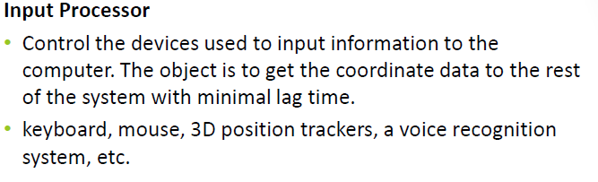
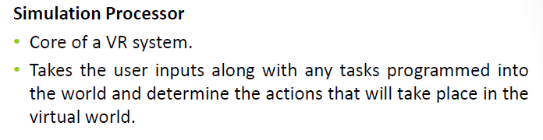
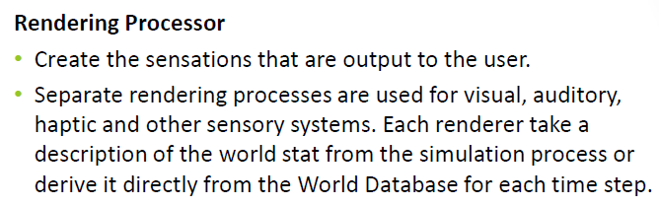

Slide 17
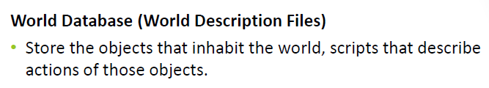
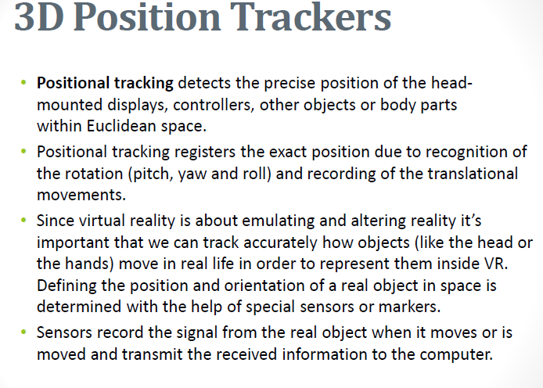

Slide 18
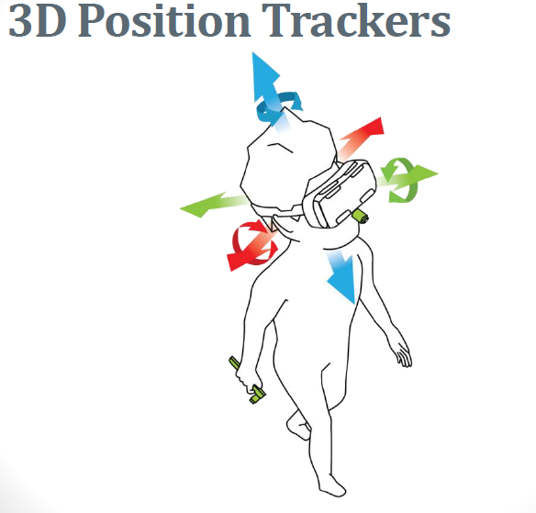
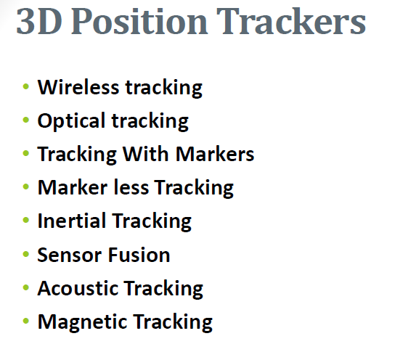

Slide 19
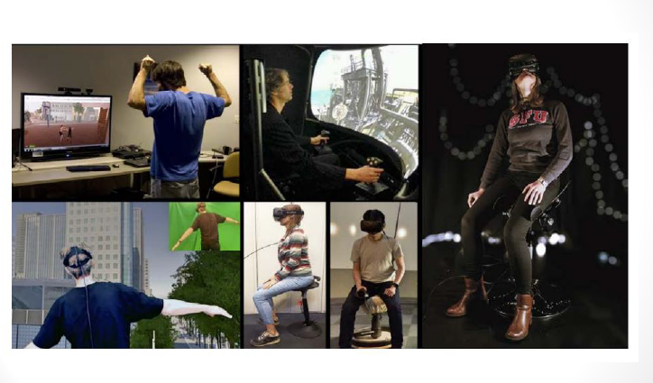

Slide 20
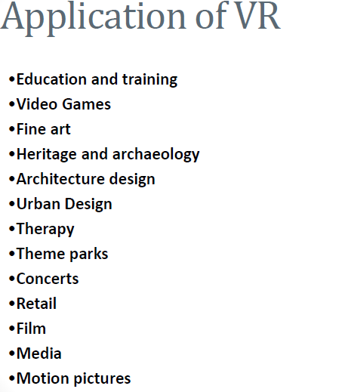

Slide 21
Applications of VR
Flight simulation
For pilot training
Safe and realistic
Risk free
Medicine
Practice performing surgery.
Perform surgery on a remote patient.
Teach new skills in a safe, controlled environment.
Education and training
Driving simulators.
Ship simulator
Flight simulator
Engineering and design
CAD and CAM
View products as it would be seen when manufactured

Slide 22
Human factor modeling
Used to model human behavior in the design of new products or buildings
E.g. simulation of fire in a building and a user can view how the virtual occupants react to the
emergency
Visualization
Data visualization
Military
Computer Animation
Computer Animation generally refers to any time sequences of visual changes in a scene.
Computer animation is the process used for generating animated images (moving images) using computer graphics.
Applications:
Entertainment (Motion picture and cartoons)
Advertising
Scientific and Engineering studies
Training and Education

Slide 23
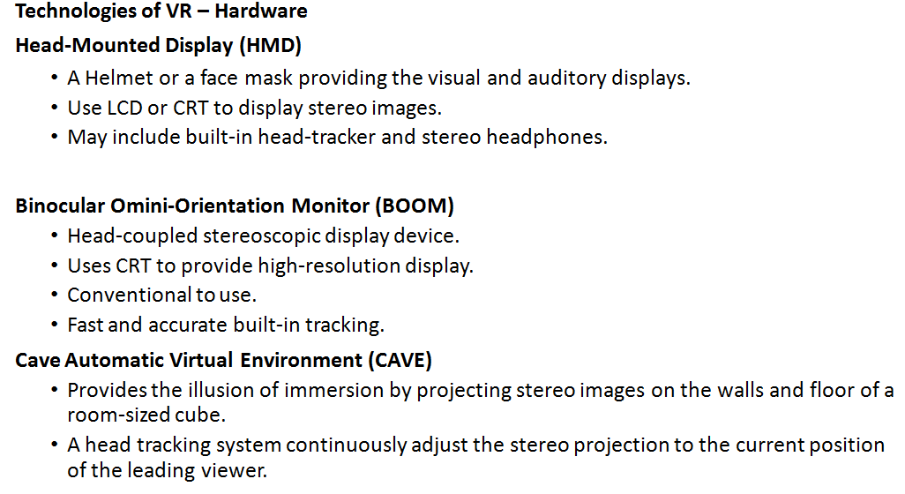

Slide 24
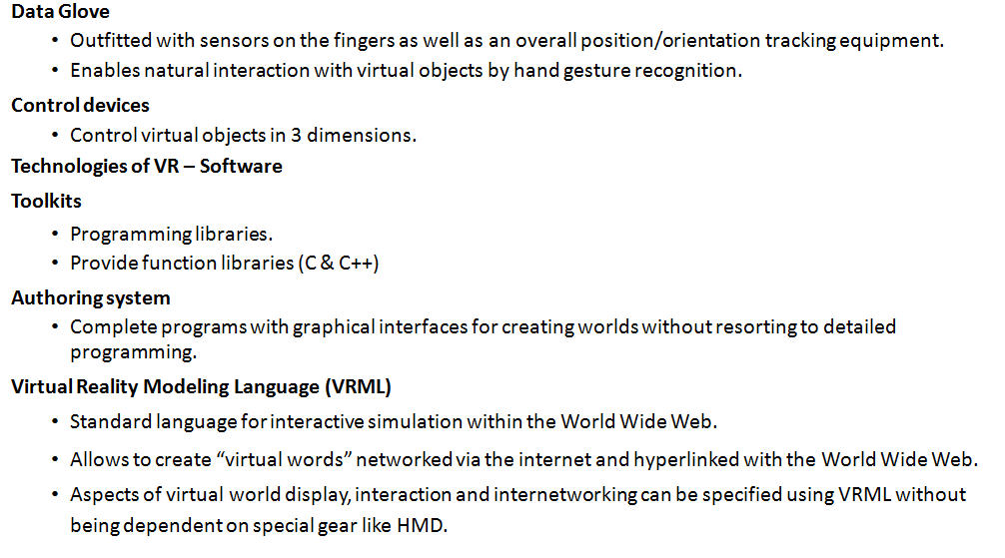

Slide 25
